Slide 1
Liver Fibro – CK Generation
1. 개요
Objective
- HE Image -> CK Image 생성
* Metrics : 원본 CK Image와 생성한 CK Image의 갈색 Tissue 면적 비교
Data Explanation
- Total : 10장 (2102 ~ 2404)
* HE -> Restain -> IHC

Slide 2
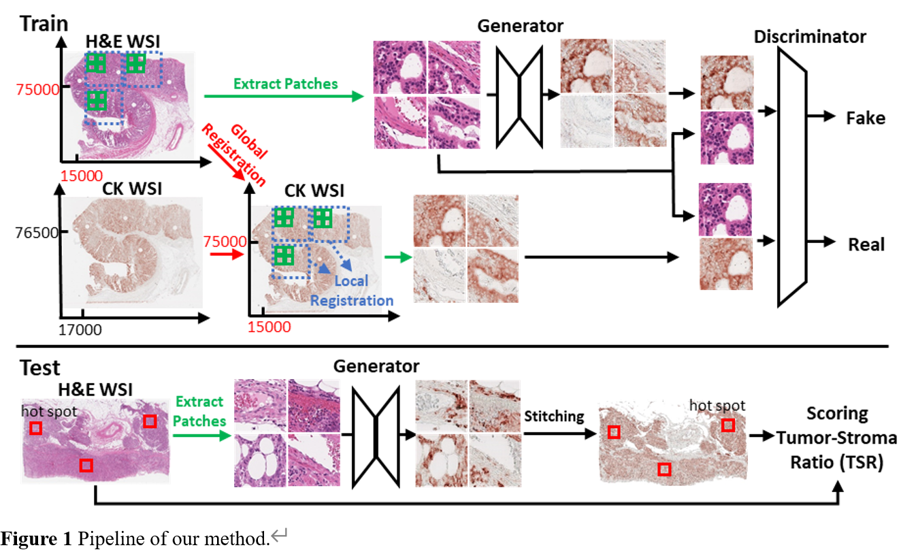
2. Process
<전체 Process 요약>

Slide 3
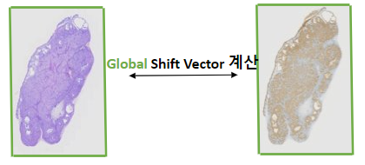
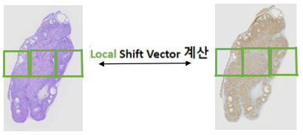
2. Process
2-1 Registration
- HE와 CK의 tissue 위치를 일치시키기 위한 작업
2-1-1 Global Registration
2-1-2 Local Registration
※ Shift Vector : Image를 상, 하, 좌, 우로 얼만큼 움직일지에 대한 수치값

Slide 4
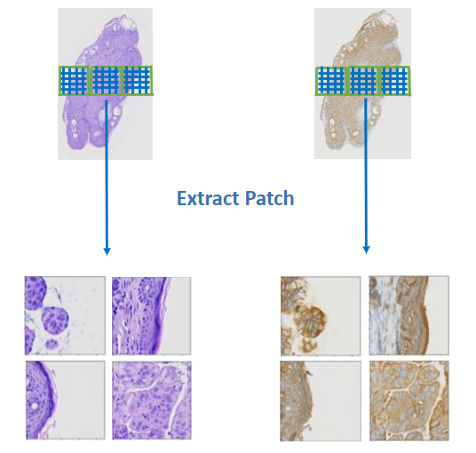
2. Process
2-1-3 Extract Patch

Slide 5
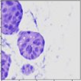
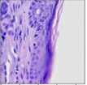
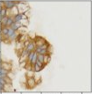
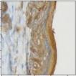
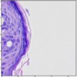
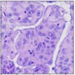
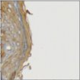
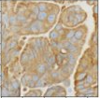
2. Process
2-2 Pix2Pix Algorithm
Original HE
Generator
Prediction CK
Original CK
2-3 Metrics
갈색 tissue 면적
오차 계산
갈색 tissue 면적
Original CK의
Prediction CK의
전체 tissue 면적
전체 tissue 면적

Slide 6
3. Result
<결과표>
Test Case | Image | Total Area | Brown Area | Brown/Total | 오 차
2103 | Original | 10438820 | 4675588 | 44.79% | 0.41%
 | Prediction | 10438820 | 4719267 | 45.2%
2105 | Original | 12600689 | 5533084 | 43.91% | 0.2%
 | Prediction | 12600689 | 5558958 | 44.11%
2307 | Original | 11703263 | 5206686 | 44.48% | 0.53%
 | Prediction | 11703263 | 5268212 | 45.01%
2308 | Original | 10438820 | 2298784 | 39.26% | 1.46%
 | Prediction | 10438820 | 2384336 | 40.72%
2404 | Original | 3627230 | 3627230 | 41.67% | 0.11%
 | Prediction | 1511747 | 1507776 | 41.56%

Slide 7
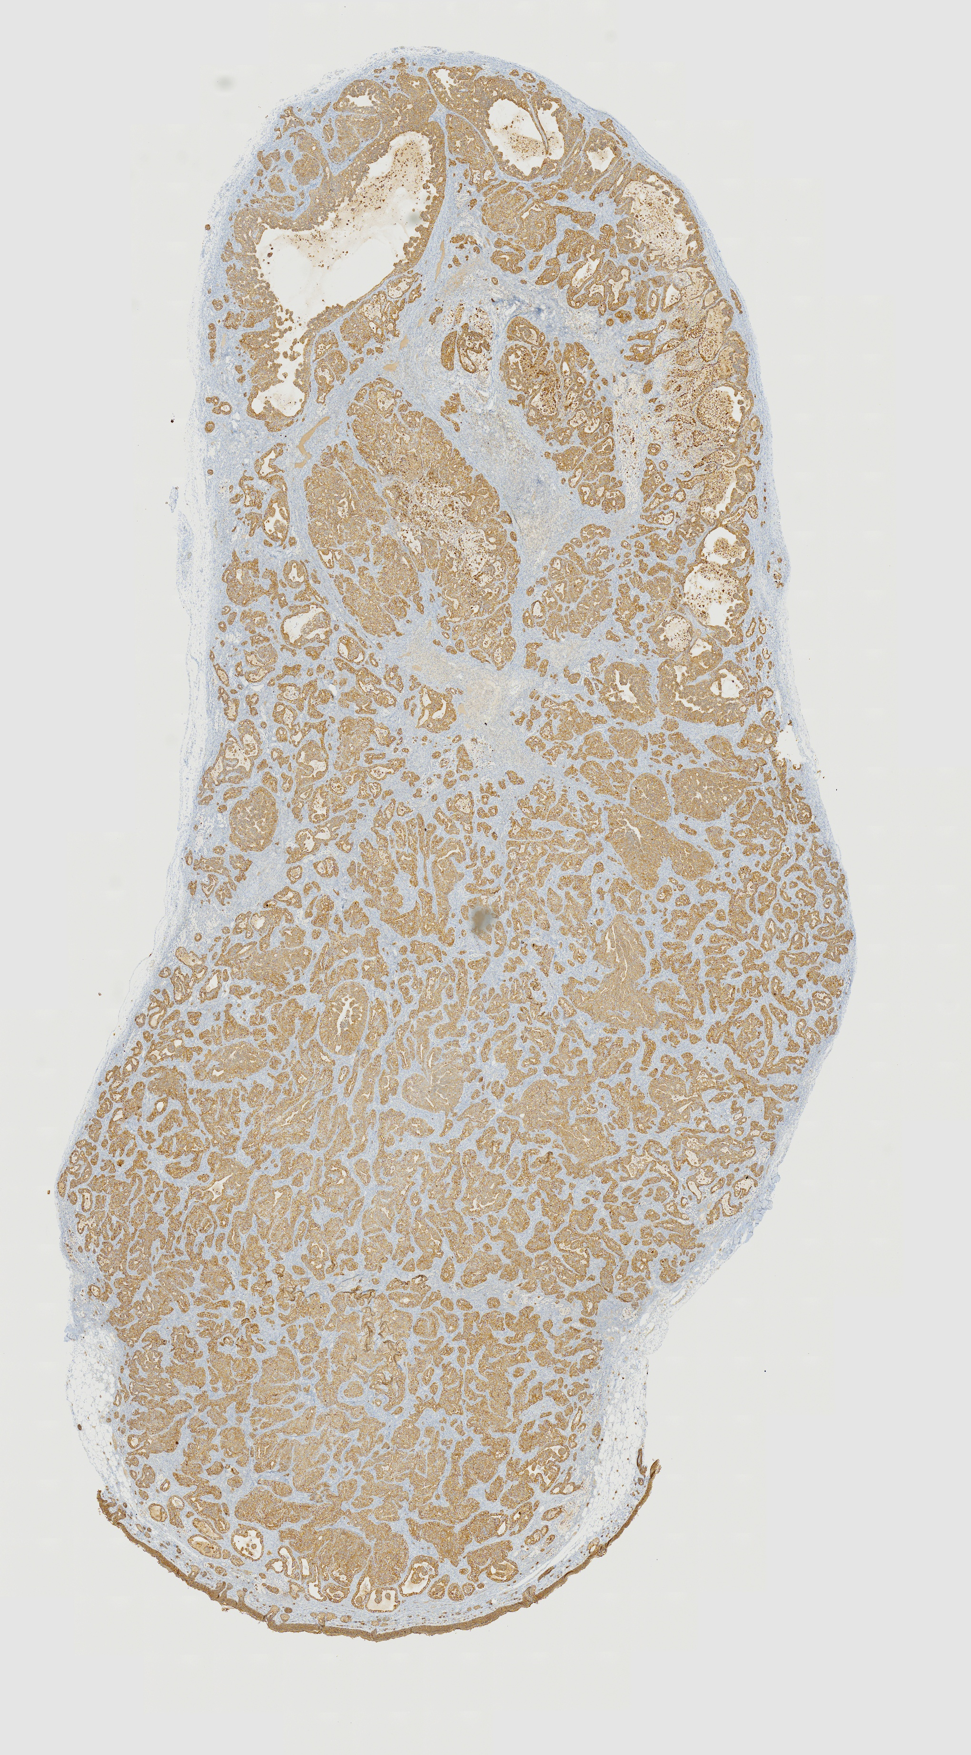
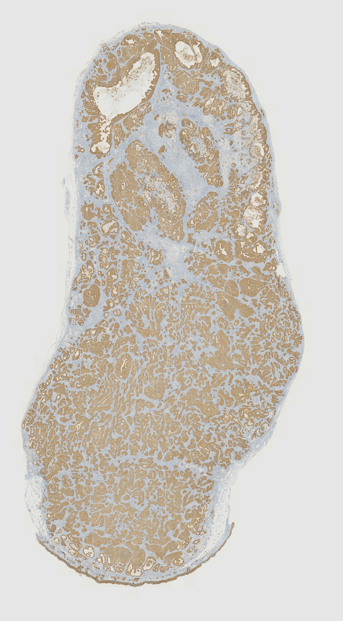
2105 Original
2105 Prediction

Slide 8
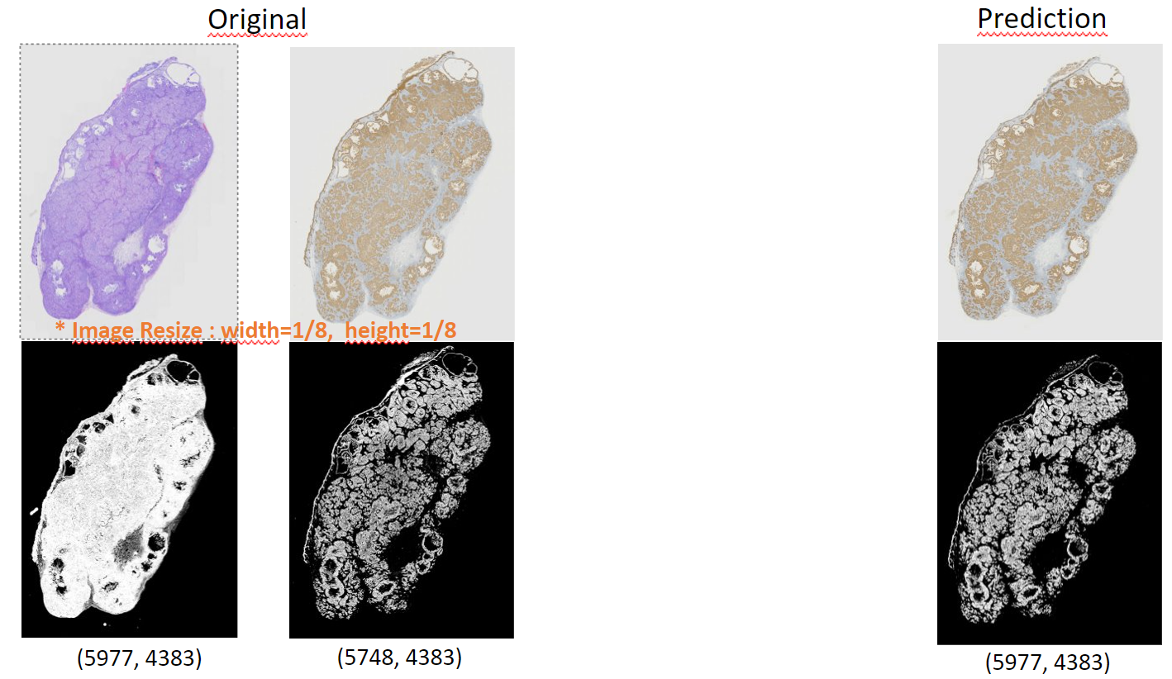
3. Result
<2103>
Brown Rate : 44.79%
Brown Rate : 45.2%
* Total Area : HE-> RGB2GRAY -> threshold : 220 Binarization
Brown Area : IHC-> Color Deconvolution(DAB) -> Isodata Binarization

Slide 9
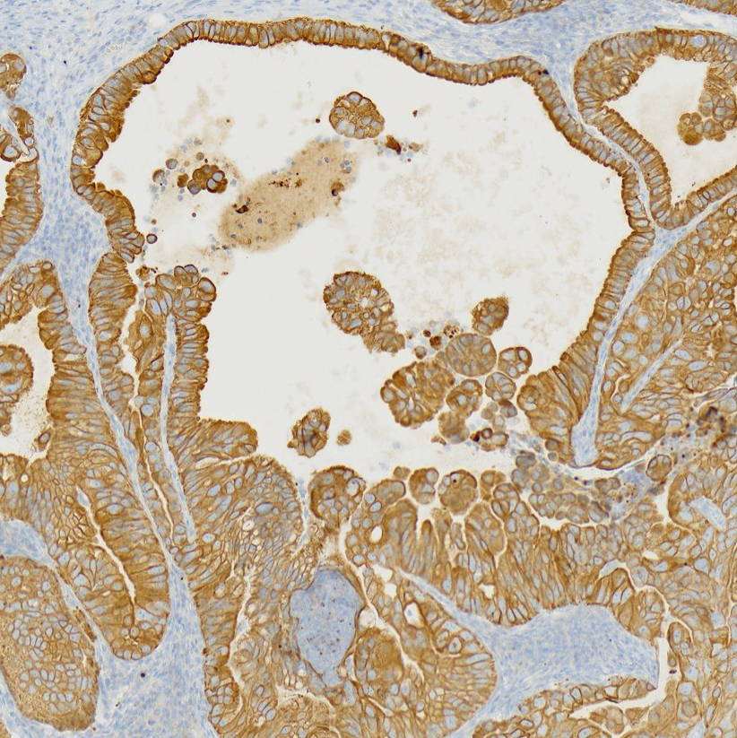
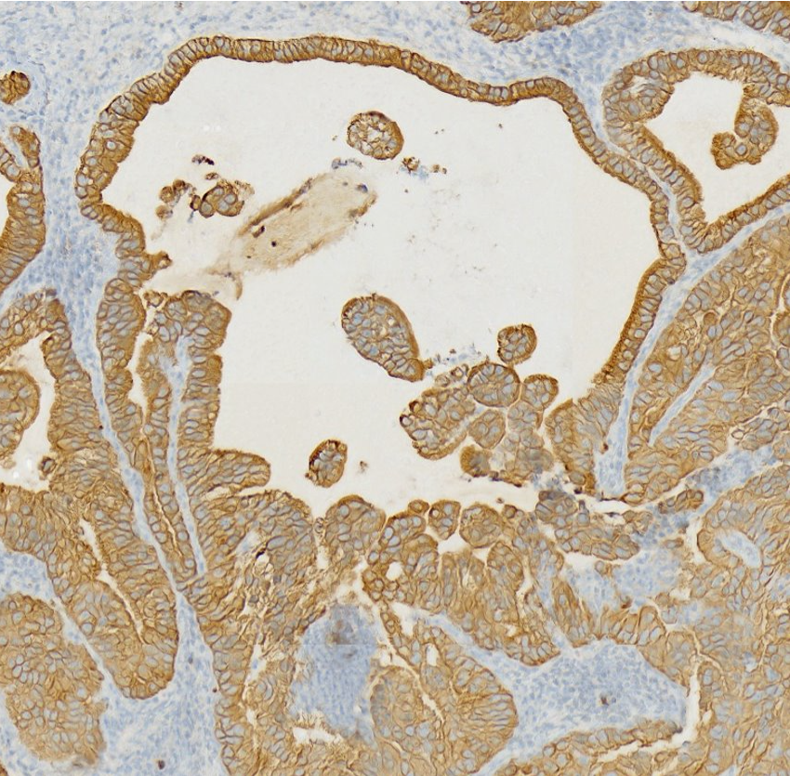
확대 비교 사진1 (2103)
Pixel Size
3000x3000
Original
Prediction

